Slide 1
Information Retrieval in Libraries: Silos and (Tentative) Solutions
Daniel Hickey
15 Sept 2010
Notes:
http://commons.wikimedia.org/wiki/File:Silos_sw.jpg

Slide 2
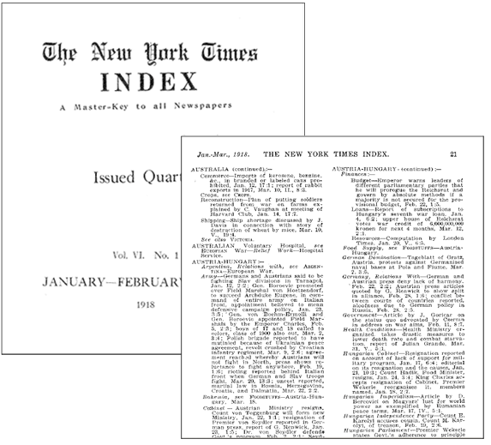
IR of Academic Information
1990
2010
Print and electronic indexes
Libraries!
Networked databases
Libraries?

Slide 3
User-Centered Perspective
Knowing which databases to use:
We offer hundreds of different databases and tens of thousands of different ejournals. Does the user know which of these are the best for their research?
Duplication of effort:
Even if the user knows which database to search, she still has to perform the same search in every database that's relevant to her topic.
Notes:
http://www.library.pitt.edu/zoom_faq.html

Slide 4
500+ Databases with…
Vastly different content
Vendor-side legacy systems
Competing metadata standards
License agreements and copyright restrictions

Slide 5
THE ECONOMIST
Notes:
http://commons.wikimedia.org/wiki/File:06_Spiral_CFL_Bulb_2010-03-08_%28white_back%29.jpg

Slide 6
Libraries are trying to meet the needs of 21st Century researchers with late 20th Century technology.

Slide 7
What’s at stake?

Slide 8
What’s at Stake?
Attrition and research integrity
Interdisciplinary research
Discoverability of
Data
Multimedia
Grey literature

Slide 9
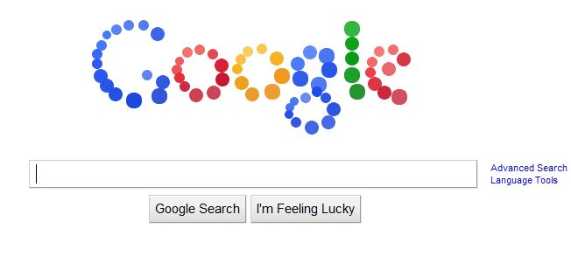
(Elephant in the room)
Notes:
http://www.bloginity.com/blog/2010/09/07/google-logo-mystery-meaning-google-homepage-balls-september7/

Slide 10
What’s at Stake?
Attrition and research integrity
Interdisciplinary research
Discoverability of
Data
Multimedia
Grey literature

Slide 11
What’s at Stake?
Attrition and research integrity
Interdisciplinary research
Discoverability of
Data
Multimedia
Grey literature

Slide 12
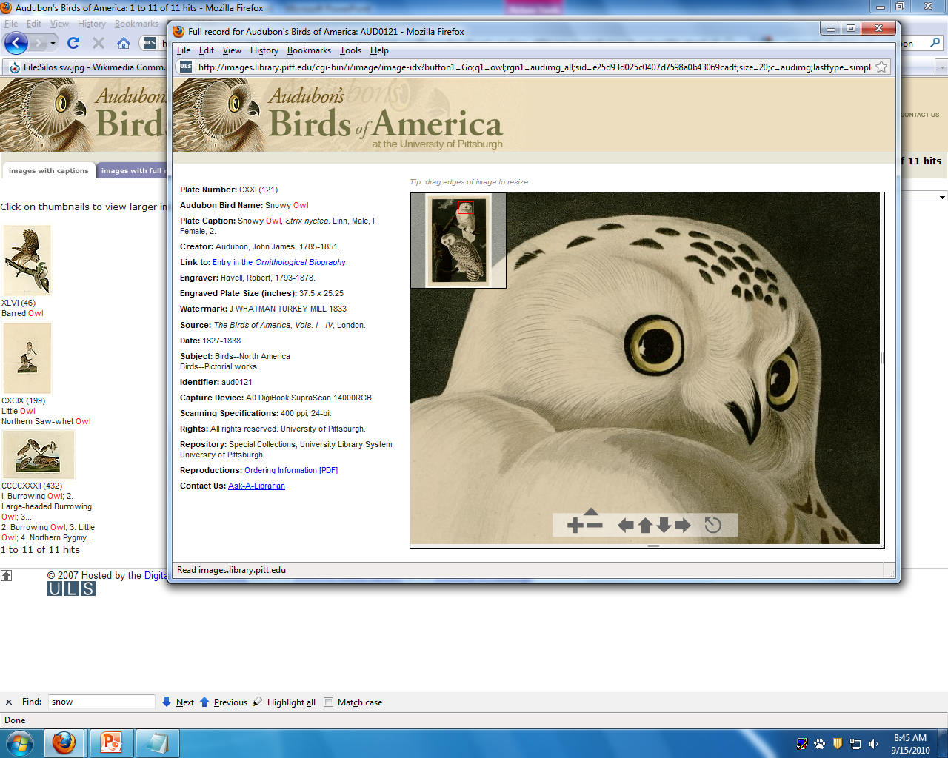

Slide 13
Solutions: First Attempts
Database directories
Federated search
Link resolvers
Metadata standards

Slide 14
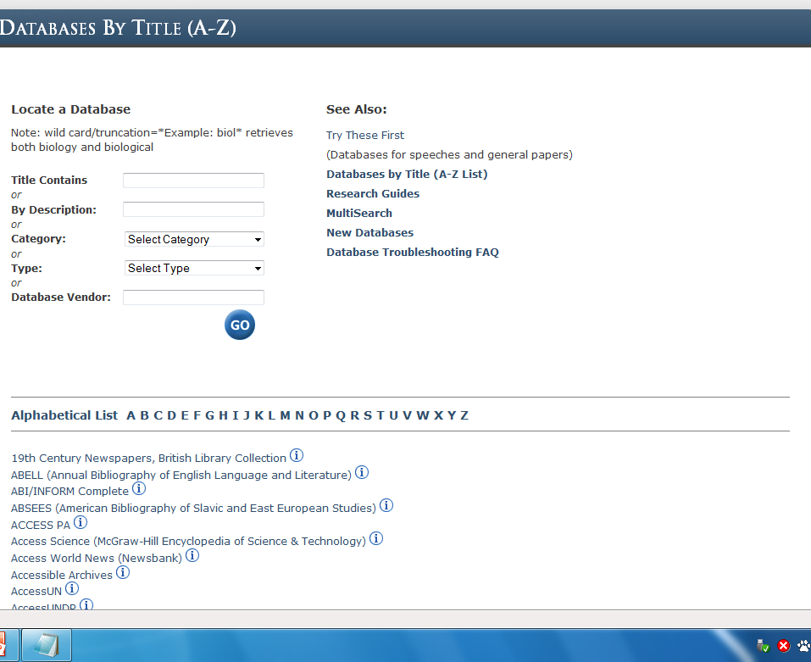
Directories

Slide 15
Solutions: First Attempts
Database directories
Federated search
Link resolvers
Metadata standards

Slide 16
Link Resolvers

Slide 17
Solutions: First Attempts
Database directories
Federated search
Link resolvers
Metadata standards

Slide 18
Solutions: 2010
Deep index
Big Digital Machine
Linked data

Slide 19
Deep Index: Summon
Notes:
http://www.serialssolutions.com/summon/

Slide 20
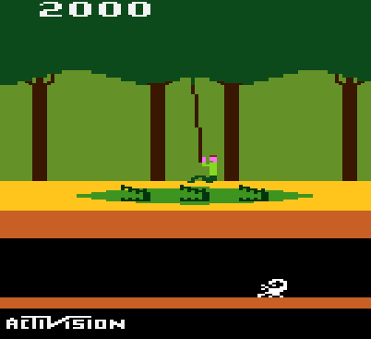
Summon Pitfalls
Prohibitively expensive
Not designed with new needs in mind:
Datasets
Multimedia
Vendor-controlled / SaaS
Notes:
http://www.atariage.com/hack_page.html?SystemID=&SoftwareHackID=156

Slide 21
The Big Digital Machine “aims to provide for the production, distribution, management, and preservation of the full range of scholarly products[…] To date there have been a number of good systems developed to do parts of this work, but these developments are separate, small-scale and not integrated.”
Notes:
http://www.cni.org/tfms/2010a.spring/Abstracts/PB-big-lewis.html

Slide 22
Or…

Slide 23
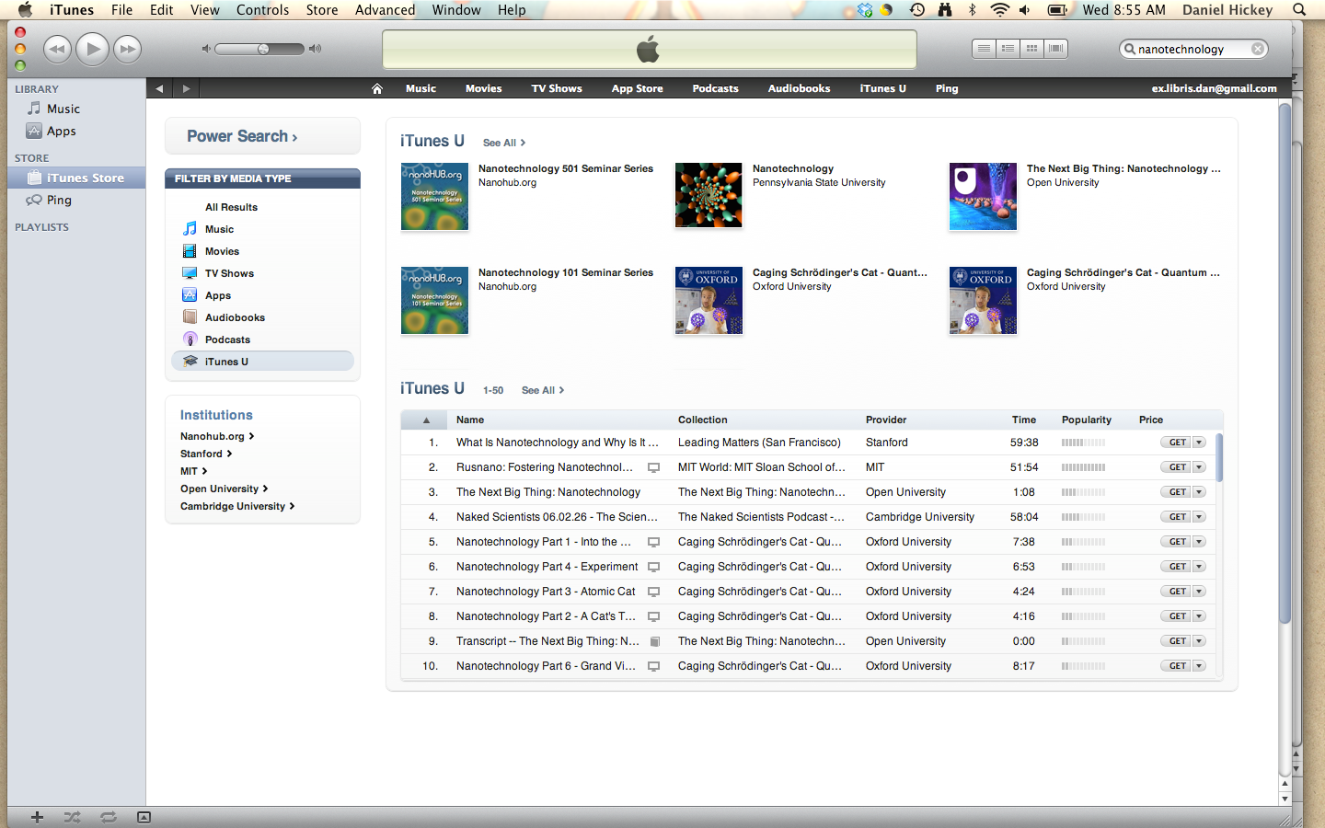

Slide 24
Big Digital Machine
Pro:
Con:
Apply successful model to new “product”
Take control of academic output / address the serials crisis directly
Provide the elusive single entry point
Untested business model
Import of current publishing system:
Industry
Peer Review / P&T
Deus ex machina

Slide 25
Linked Data
Method “of exposing, sharing, and connecting data via dereferenceable URIs on the Web”
Conceptual offshoot of the Semantic Web
Effectively untested in the academic publishing environment

Slide 26
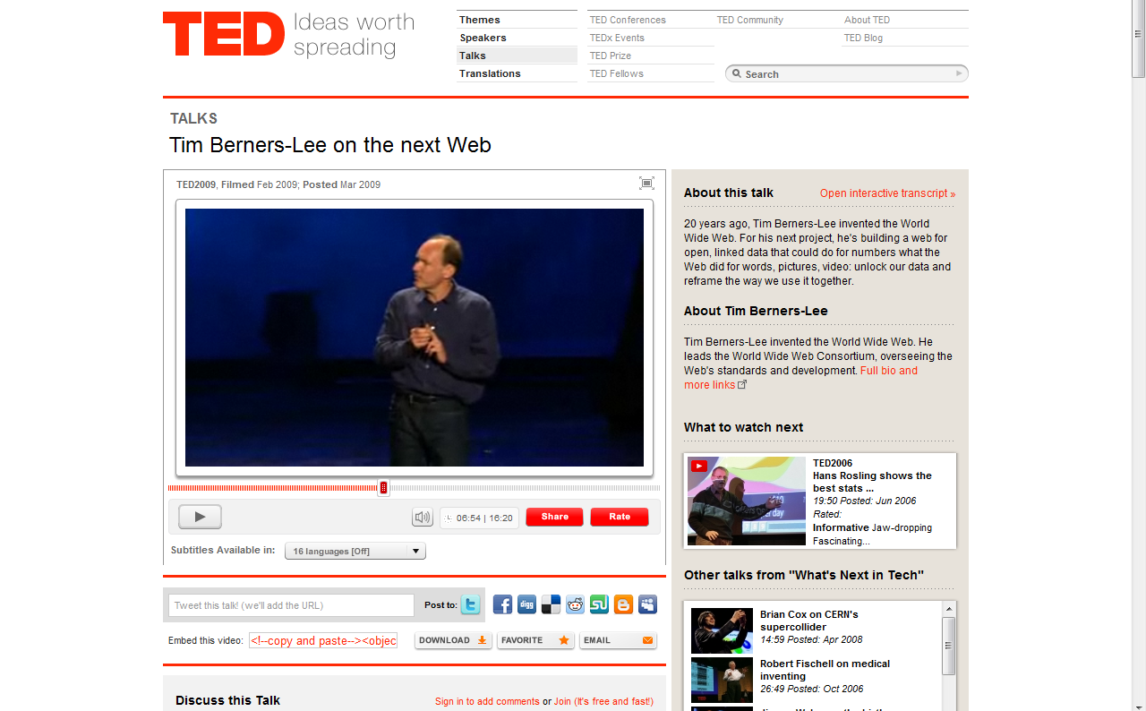
Notes:
http://www.ted.com/talks/tim_berners_lee_on_the_next_web.html
5:55 – 8:14

Slide 27
Linked Data
Tim Berners-Lee:
Use URIs as names for things
Use HTTP URIs so that people can look up those names
When someone looks up a URI, provide useful information, using the standards (RDF/XML, SPARQL)
Include links to other URIs so that they can discover more things

Slide 28
Comments & Questions
dhickey@psu.edu

