Slide 1

Mining Following Relationships in Movement Data
Zhenhui Jessie Li, Fei Wu
Pennsylvania State University
Margaret Crofoot
UC Davis
ICDM Conference
Dallas, Texas
December 8, 2013

Slide 2







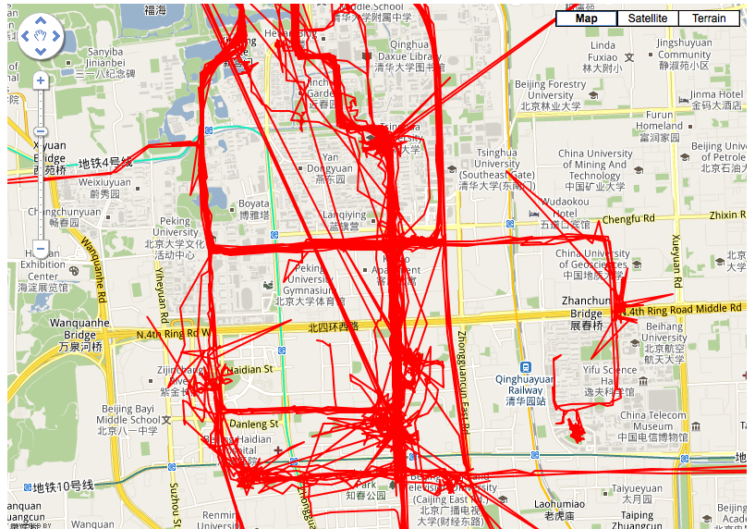
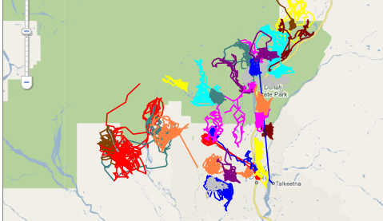
Booming Age of Spatial and Temporal Data
Advanced satellite, sensors, RFID, and wireless technologies:
Prevalence of mobile devices such as smart phones
GPS embedded in cars
Sensors attached on animals
A trajectory: A sequence of timestamps and locations
ID | Timestamp | Location
“Peter” | 2010-04-02 13:12 | 37.5, -122.5
“Peter” | 2010-04-02 15:22 | 37.2, -123.5
… | … | …
Human movement
Animal movement

Slide 3
Moving Object Relational Patterns
Periodic patterns [KDD’10, KDD’12]: self relationship, repeated behavior
Swarm pattern [VLDB’10]: moving object clusters
Follower pattern: moving together but with time lag

Slide 4
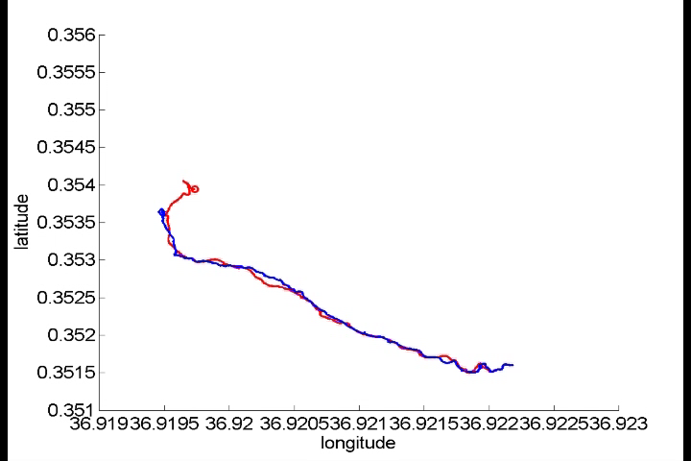
Challenges in Detecting Following Patterns
Problem: Given two moving objects R=r₁r₂r₃…r_{n} and S=s₁s₂s₃…s_{n}, find the time intervals that R follows S
1. The following time lag is varying
  - follow with lag 1 minute to 10 minutes
2. Trajectories are highly dynamic
  - follower may take different routes
3. Following only happens in a short period of time
  - 9 minutes following interval in an one-year tracking period
click the image to play video

Slide 5
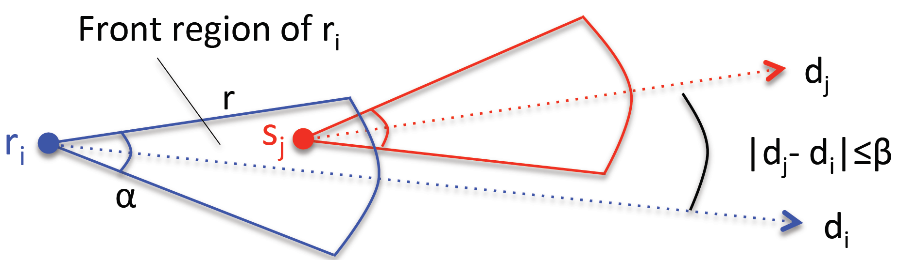
Previous Work: Find Following Patterns Using Front Region
Three parameters to define front region:
Problem: Leader may not necessarily be in the front region
s₁
s₅
s₂
S | s1 | s2 | s3 | s4 | s5
R | r1 | r2 | r3 | r4 | r5
in front region | no | yes | no | no | yes
s₃
s₄
r₂
r₃
r₅
r₁
r₄
Laube and Imfeld: REMO: Analyzing Relative Motion within Groups of Trackable Moving Point Objects. GIScience 2002
Andersson, Gudmundsson, Laube, and Wolle: Reporting Leaders and Followers among Trajectories of Moving Point Objects. GeoInformatica 12(4) 2008

Slide 6
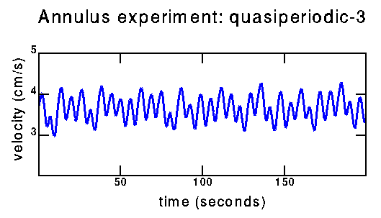
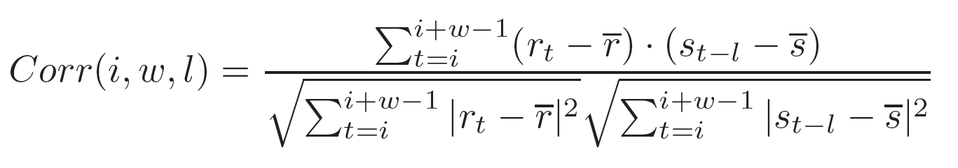
Previous Work: Correlation-Based Method
Cross Correlation:
A frequently used method in time series to measure the similarity between lagged time series
time window w
R
starting point i
S
time lag l
Problem:
Assume a constant time lag
Enumerating three parameters will report many duplicate time intervals, cannot dig out the true interval
Expensive time: O(n⁴)
Shirabe. "Correlation analysis of discrete motions." Geographic Information Science. 2006.

Slide 7
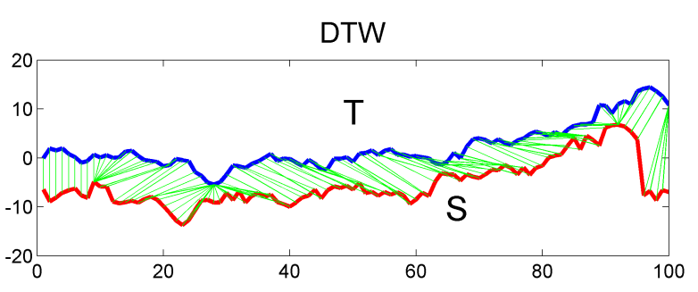
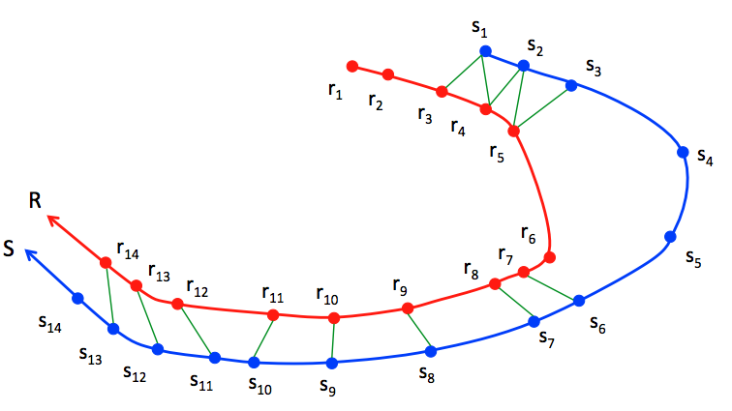
Dynamic Time Warping Idea to Handle Varying Time Lags
A following pair: ri follows sj
(1) dist(ri, sj) ≤ d_{max}
(2) 0< i-j ≤ l_{max}
d_{max}
l_{max} = 3
* green lines indicate following pair

Slide 8
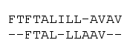

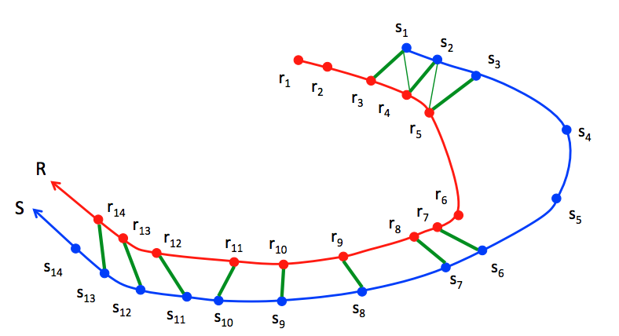
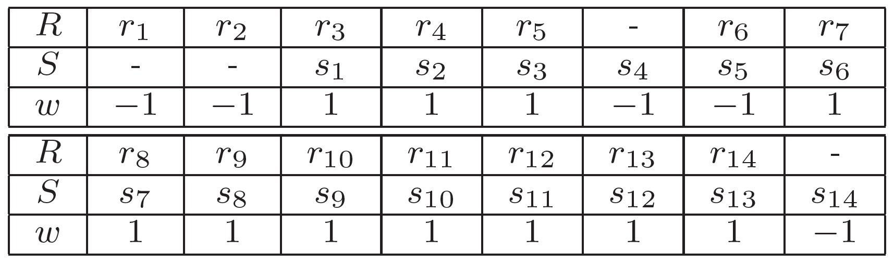
Find Following Intervals using Local Sequence Alignment (LSA)
Find following time intervals = best local sequence alignment
  DTW (minimize distances) → LSA (maximize matchings)
  Use dynamic programming
Optimal matching: R[3:14] match with S[1:13]
Notes:
local sequence alignment to find local following intervals

Slide 9
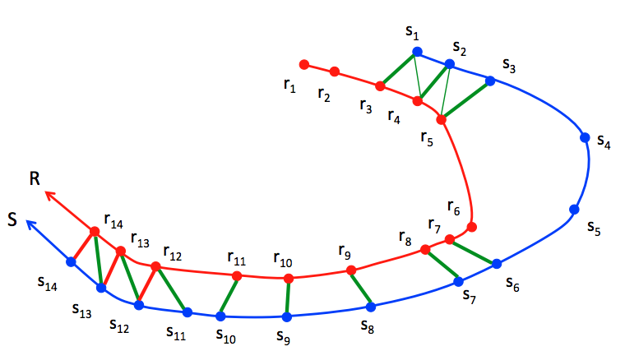
LSA “Greedily” Maximizes Alignment Score
Optimal matching: R[3:14] match with S[1:13]
R[12:14] moves with S[12:14]
Problem with LSA: cannot differentiate “following” from “moving together”

Slide 10
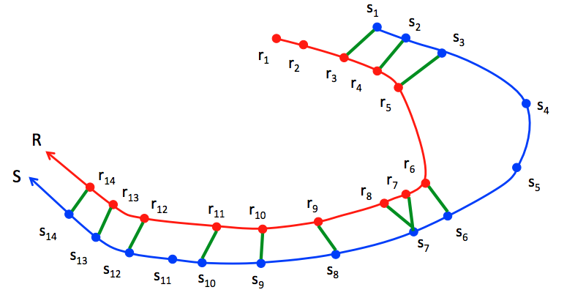
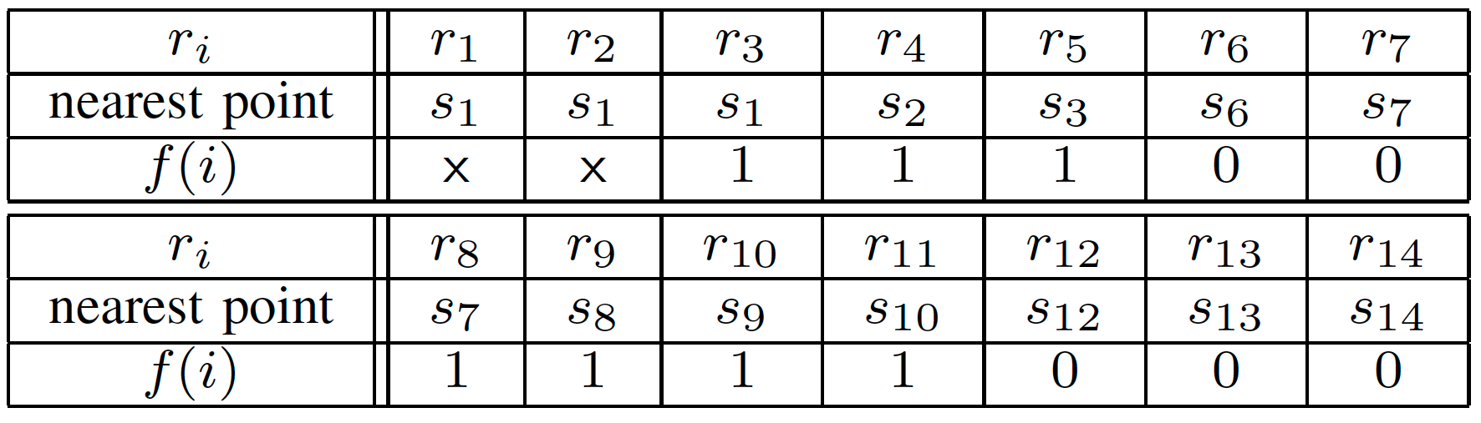
Local Minimizer to Differentiate “Following” from “Moving Together”
sj is the Local Minimizer to ri
(1) sj (j in [i-l_{max}, i+l_{max}]) is the closest point to ri
(2) dist(ri, sj) ≤ d_{max}
* green line indicates local minimizer
if sj is the local minimizer for r_{i}
j < i, f(i) = 1(ri follows sj)
j ≥ i, f(i) = 0 (ri not follow sj)
if ri has no local minimizer, f(i)=x

Slide 11
Significant Following Time Interval
if sj is the local minimizer for ri
j < i, f(i) = 1(ri follows sj)
j ≥ i, f(i) = 0 (ri not follow sj)
if ri has no local minimizer, f(i)=x
Significant following time interval I should have higher following frequency than expected
Expected following frequency:
If R and S are moving together, we expect half following (1s) and half non-following (0s)
Following score (difference between actual and expected frequency):

Slide 12
Significant Following Time Interval
Interval with maximal score:
R follows S from r3 to r11 and then moves together with S from r12 to r14

Slide 13

Experiments: Method for Comparison
REMO
not successful
2. Correlation-based method
3. LSA: local sequence alignment
not successful
moderately successful
time window w
R
starting point i
S
time lag l

Slide 14
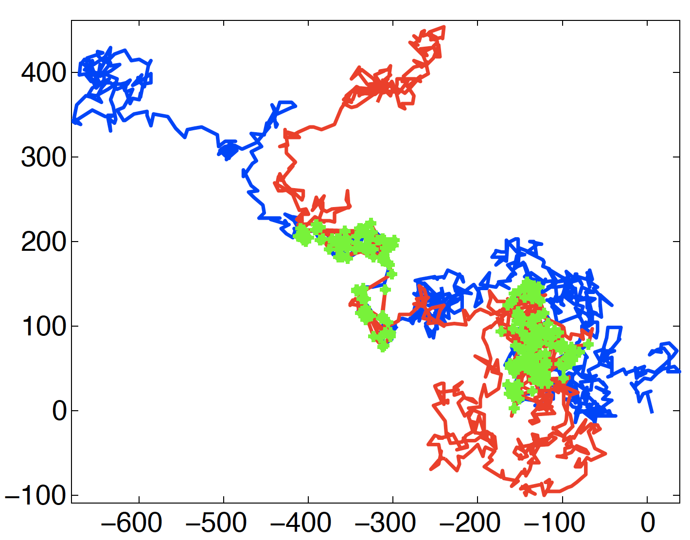
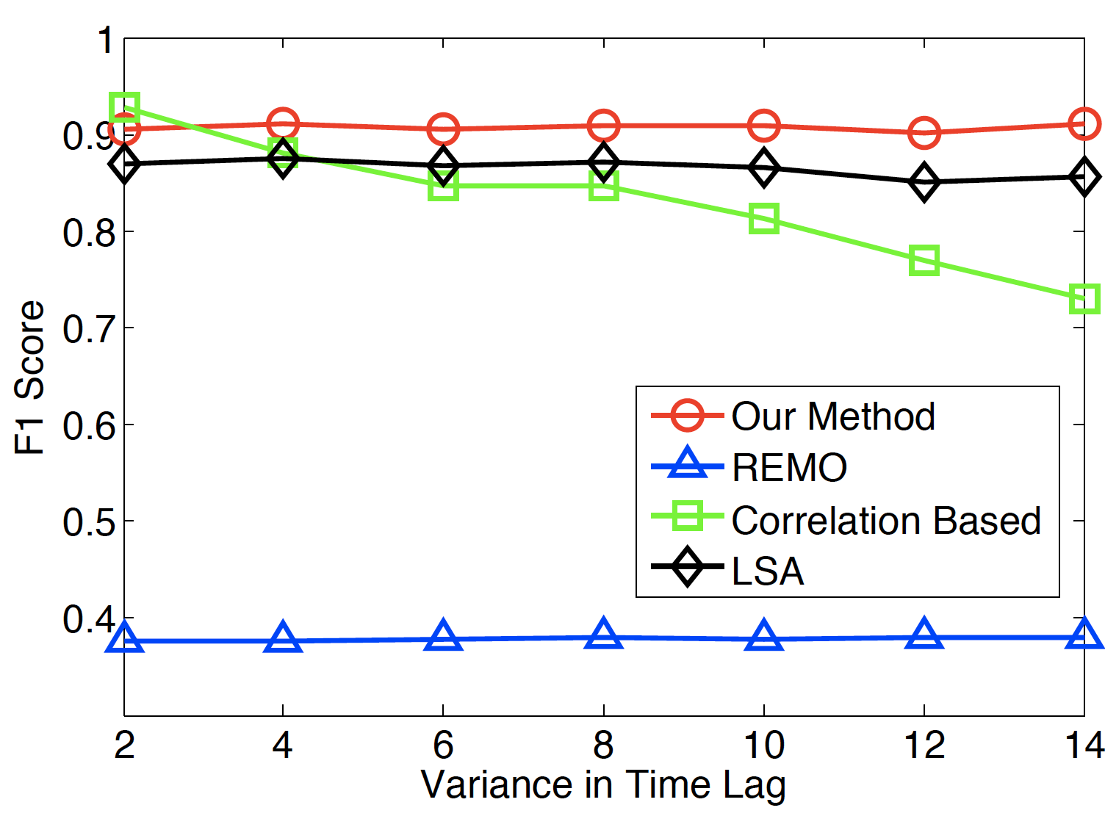
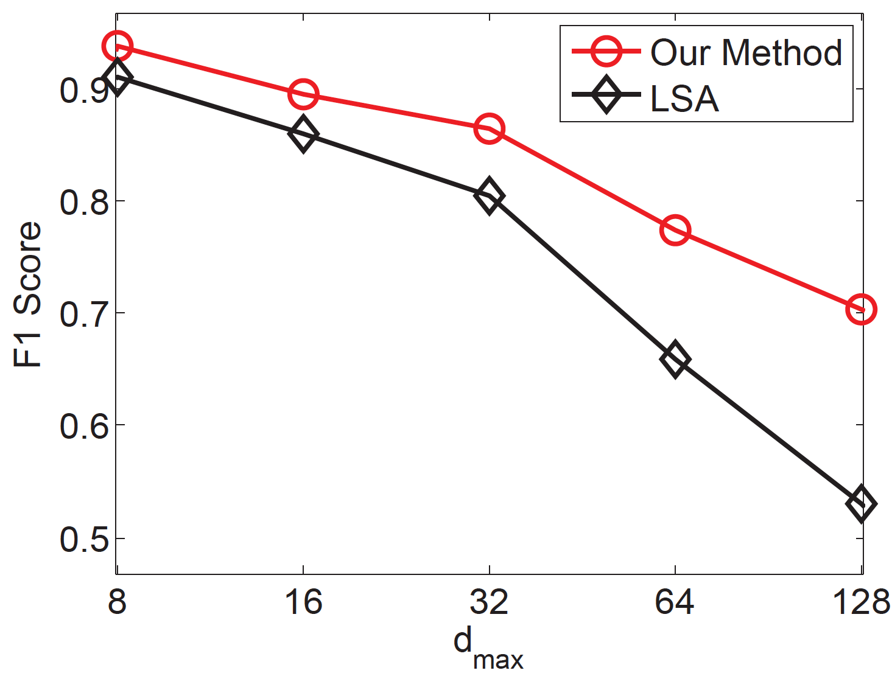
Synthetic Dataset for Effectiveness Evaluation
Synthetic data:
Generate by Rayleigh flight model (random walk)
Following time lag vary from 1 to 10
Following distance: 8
True following range: [100:250] and [700:800]
R trajectory
S trajectory
following locations

Slide 15
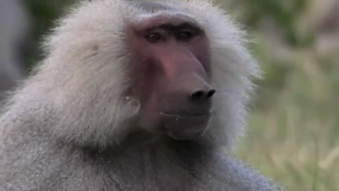
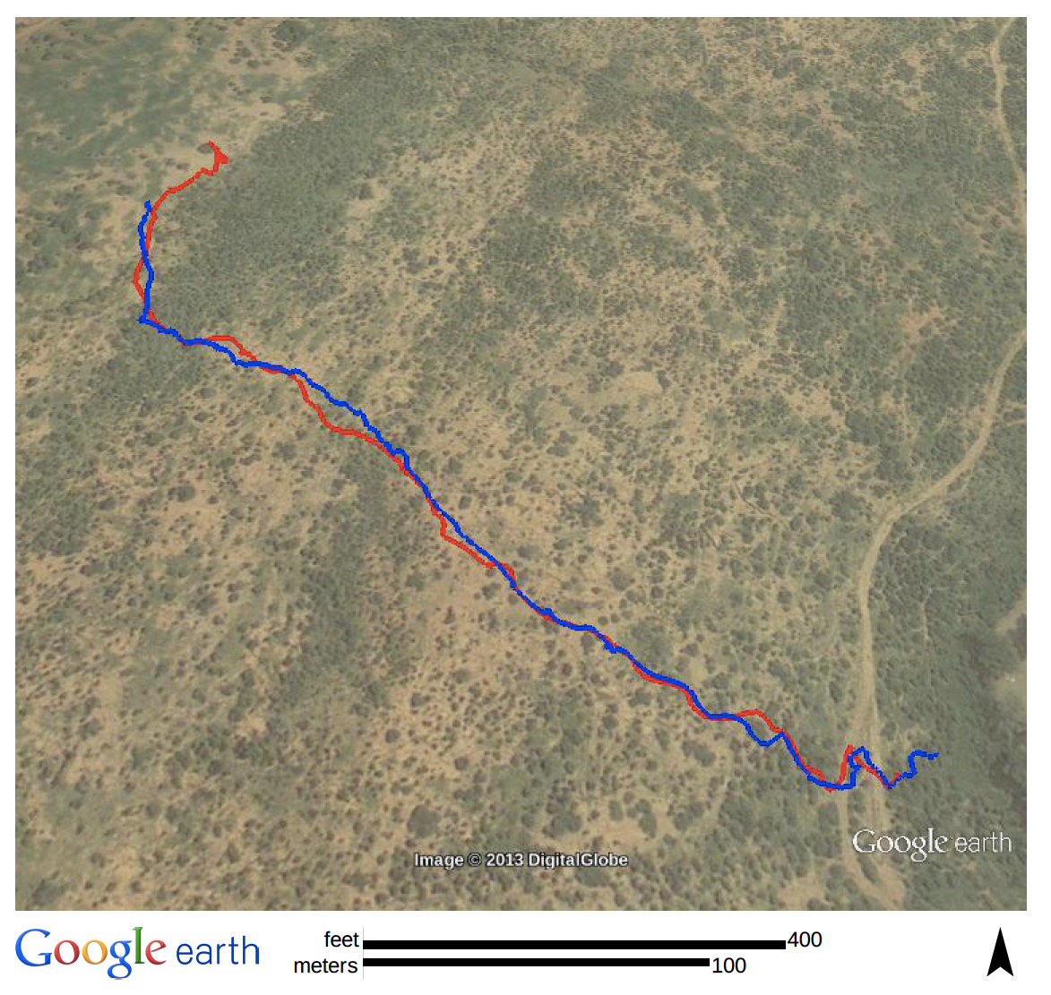
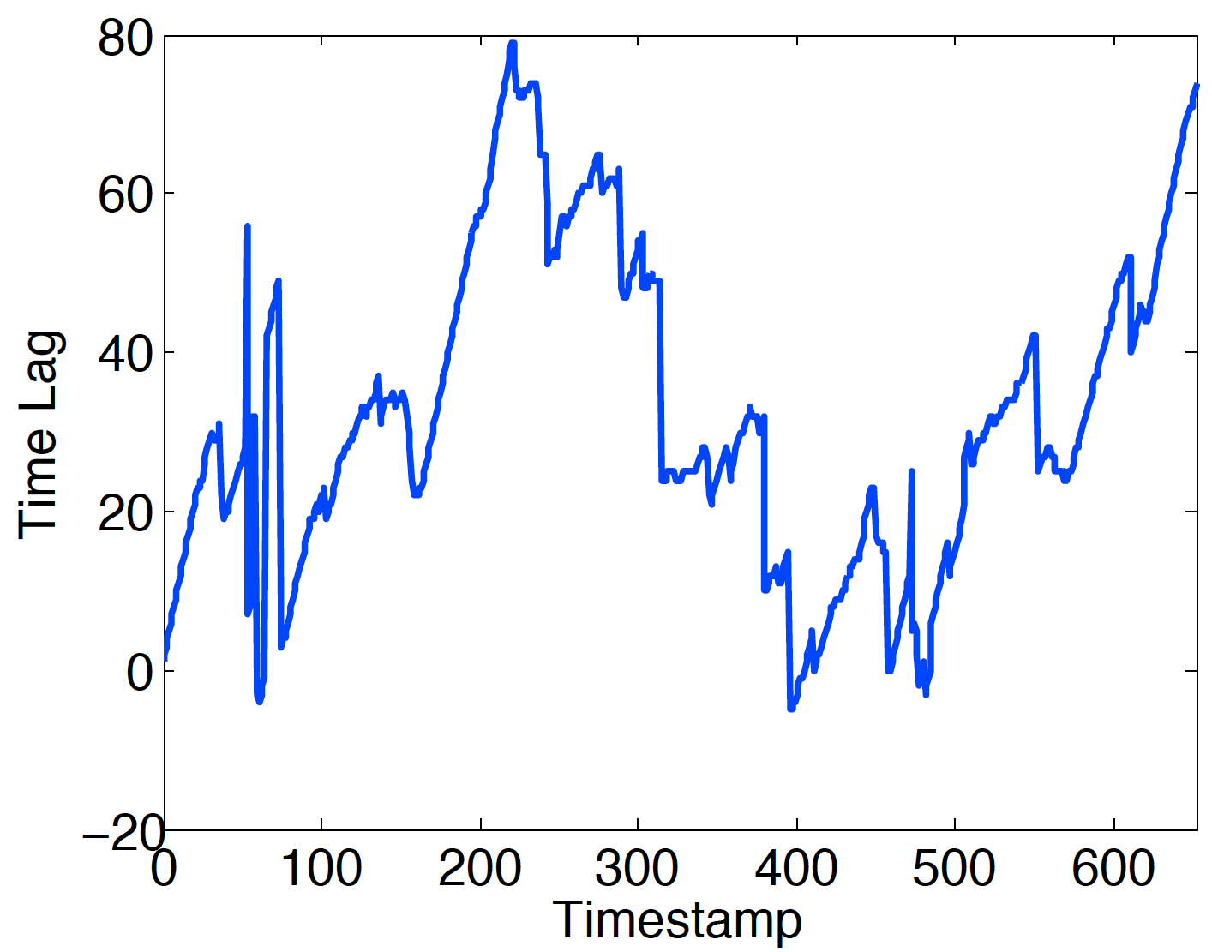
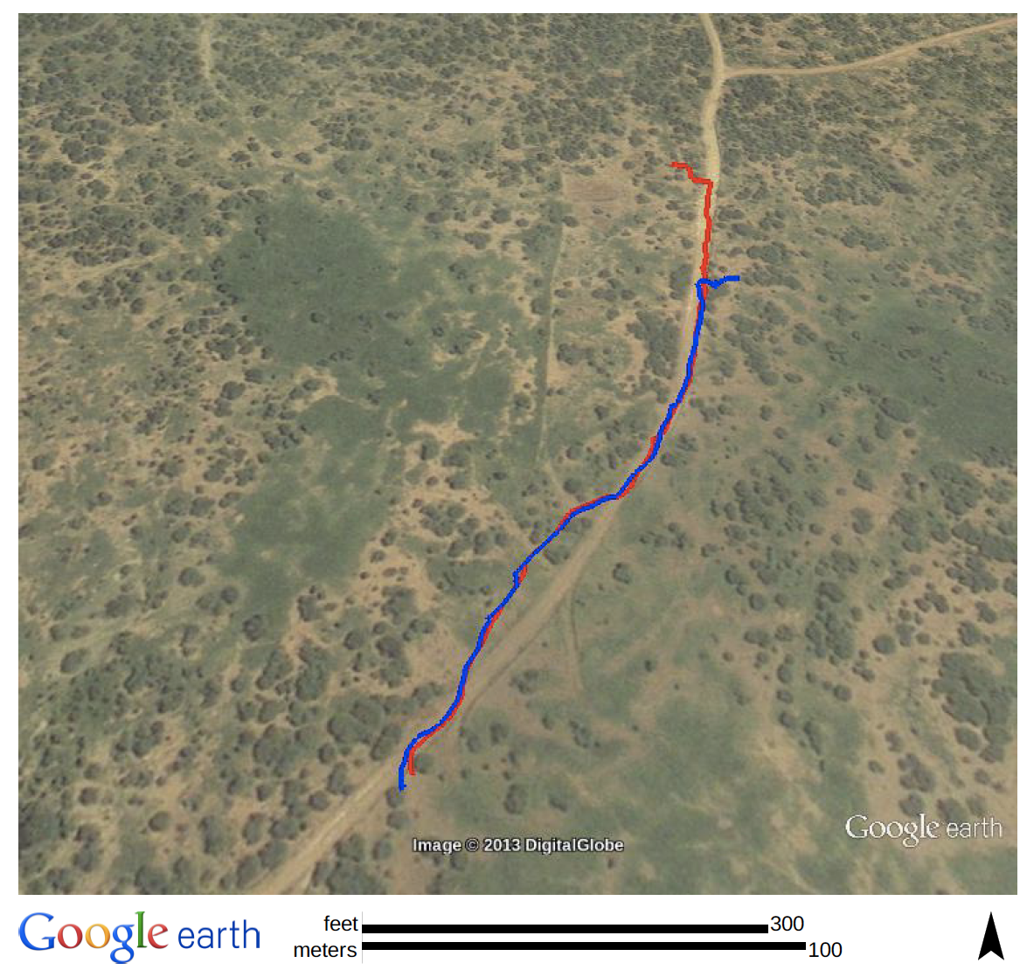
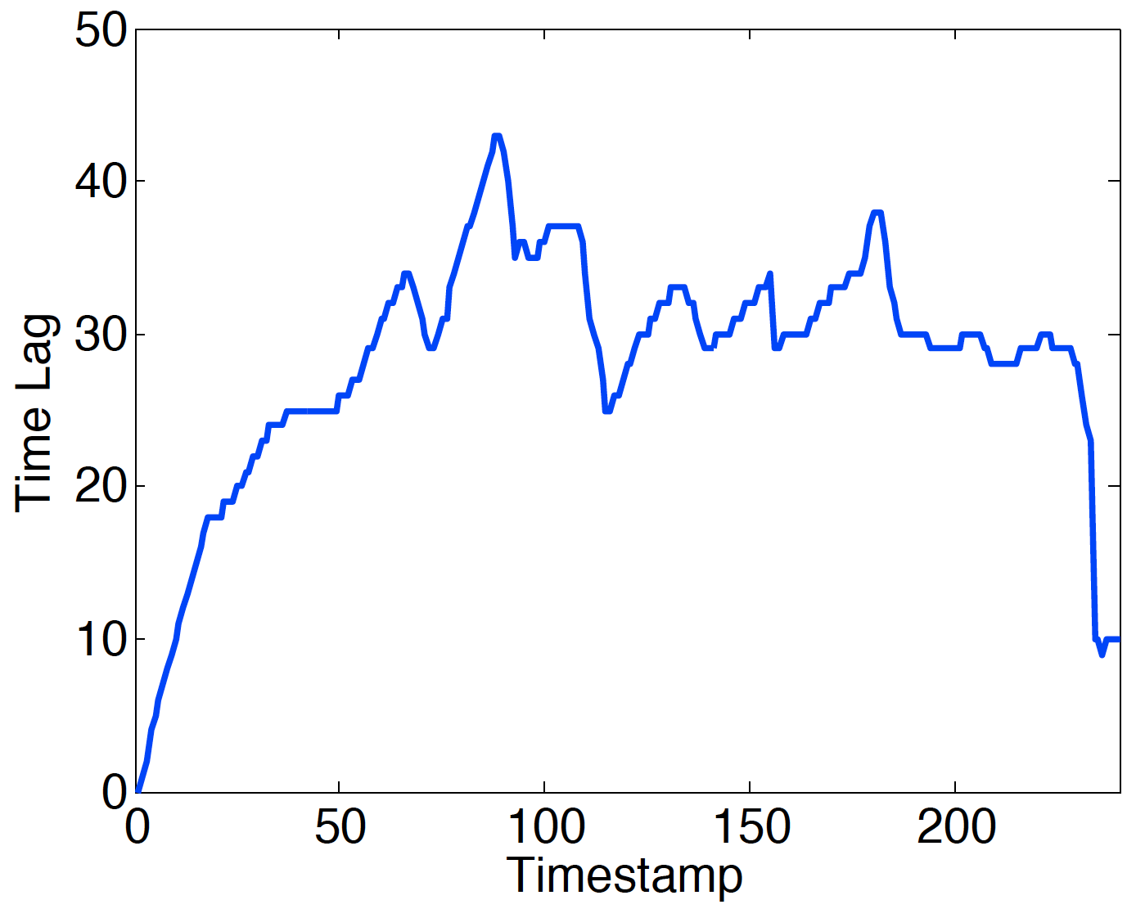
Case Studies on Real Baboon Data
26 baboons tracked from 8/1-27, 2012 in Laikipia Kenya
Sampling rate: 1 second
Parameter: d_{max} = 50 (meters), l_{max} = 60 (seconds)
Visit this webpage to see animation
click the image to play video
http://faculty.ist.psu.edu/jessieli/icdm13/following.html

Slide 16
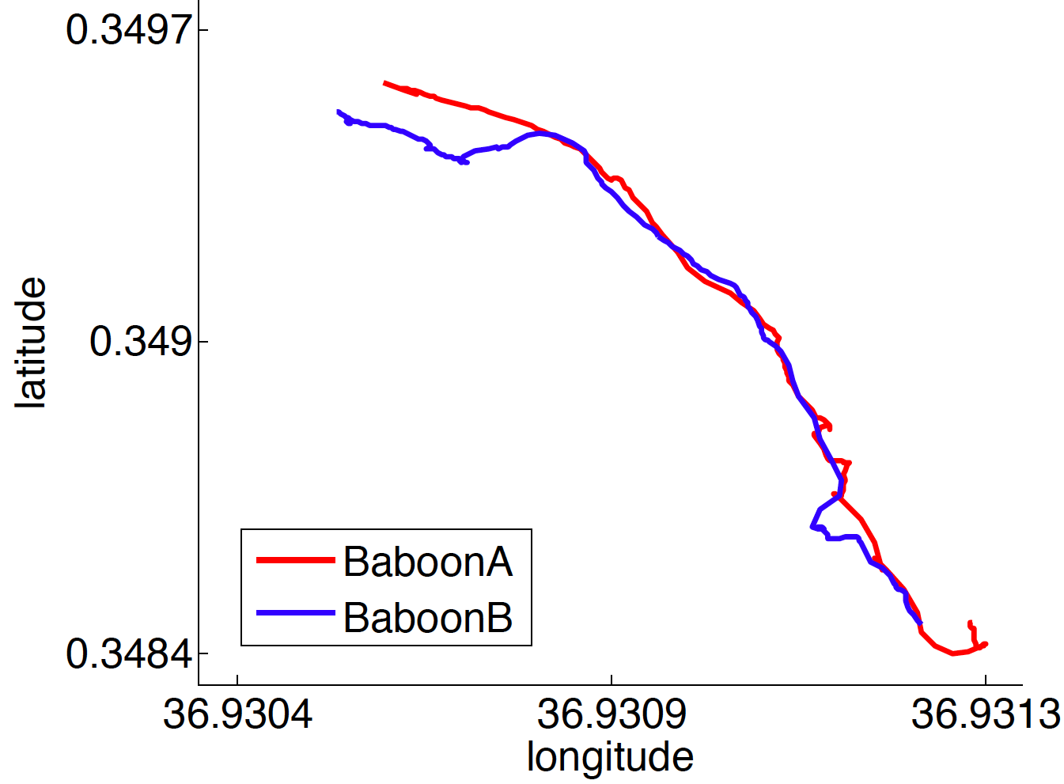
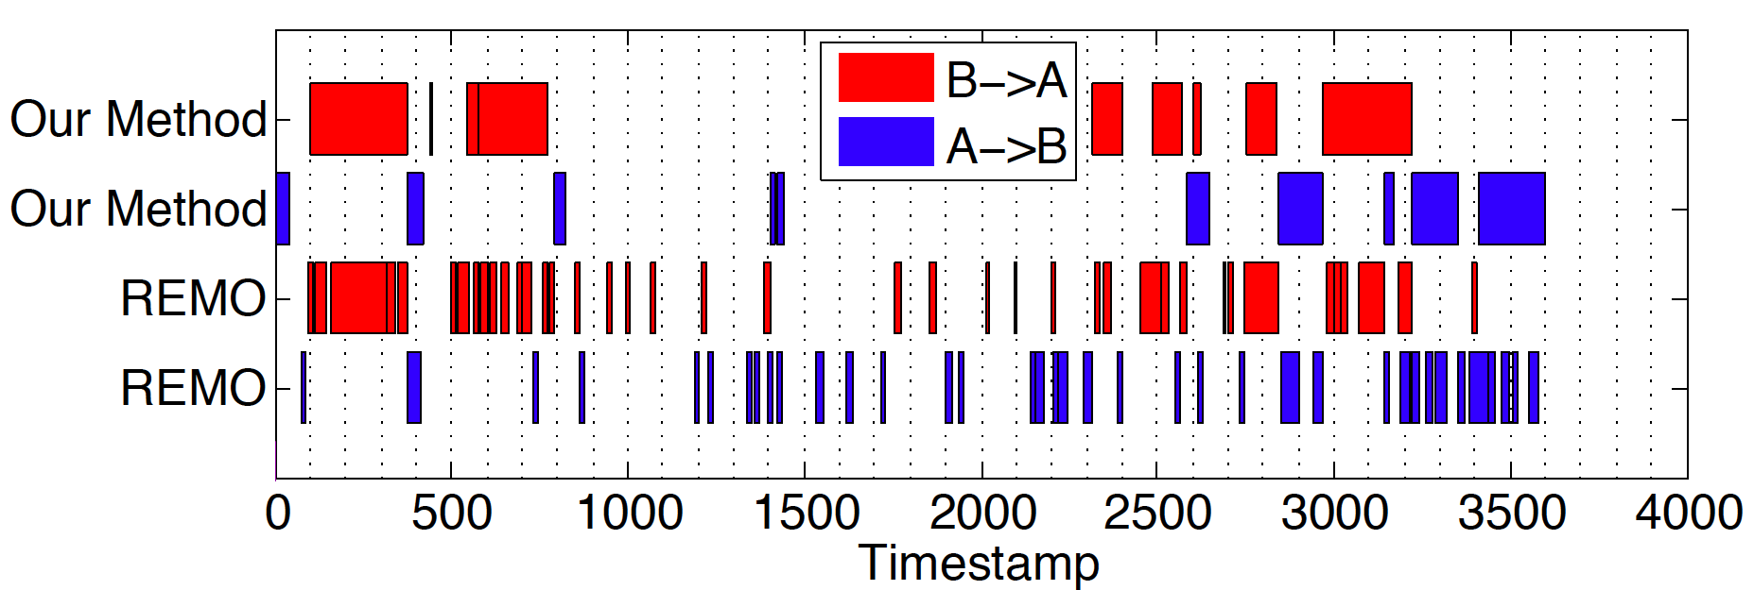
REMO Reports Many Small Intervals
Case 3. 10:00-11:00 AM August 2, 2012
[2969:3221]
REMO reports many small non-following intervals
REMO breaks this interval into many small intervals

Slide 17
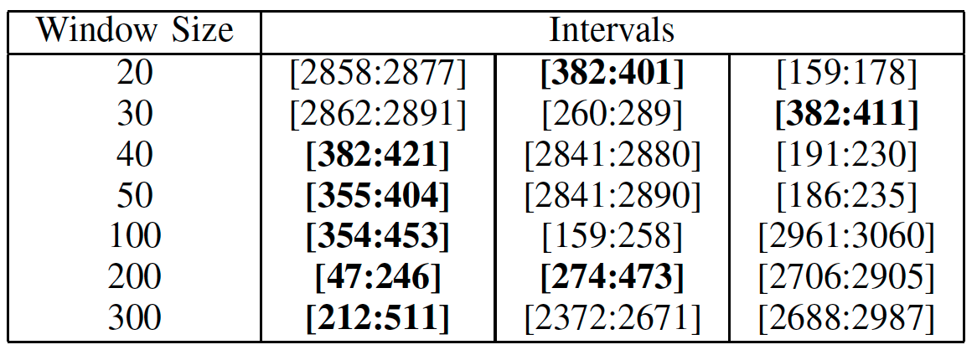
Correlation-based Method Reports Many Duplicate intervals
Case 3. 10:00-11:00 AM August 2, 2012
bold intervals: duplicate intervals

Slide 18
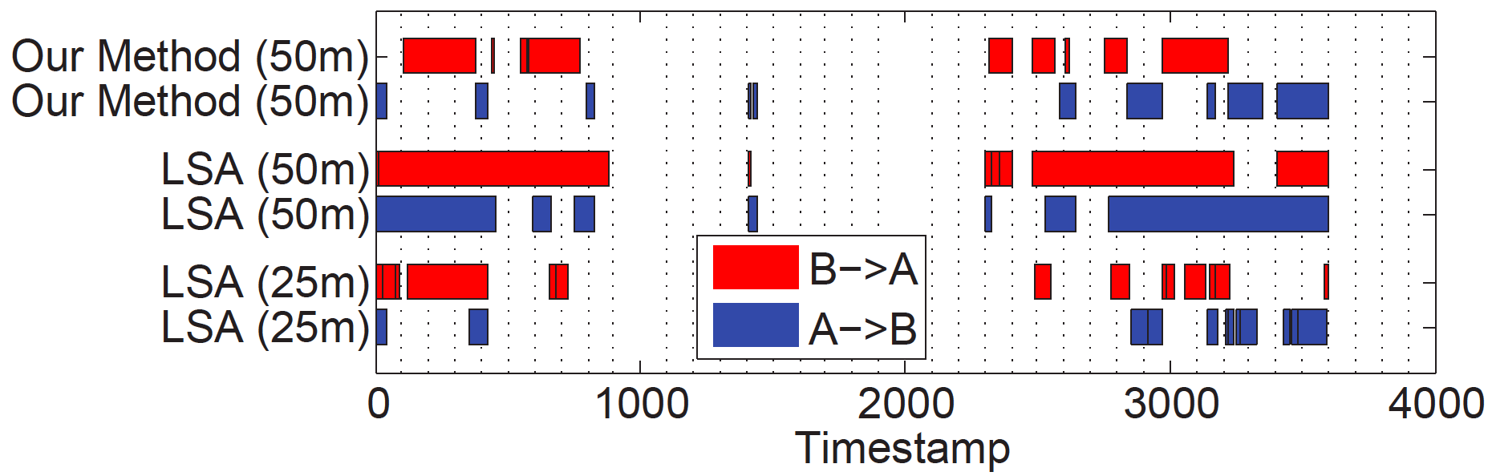
LSA is Sensitive to Distance Parameter
Case 3. 10:00-11:00 AM August 2, 2012
[2969:3221]
d_{max} = 50: treat this interval as moving together
d_{max} = 25: break it into many small intervals

Slide 19
Summary
We propose a simple but effective method to detect following time intervals between two moving objects
  local minimizer: find the closest location
  two relaxed parameters: d_{max} and l_{max}
  significant time intervals: followings more than expected
  linear complexity O(n)
Our solutions addresses real challenges
  unknown and varying time lags
  dynamics in trajectories
  subtle relationships

Slide 20
Future Work: Understand the Context
Across the forest
On the road

Slide 21
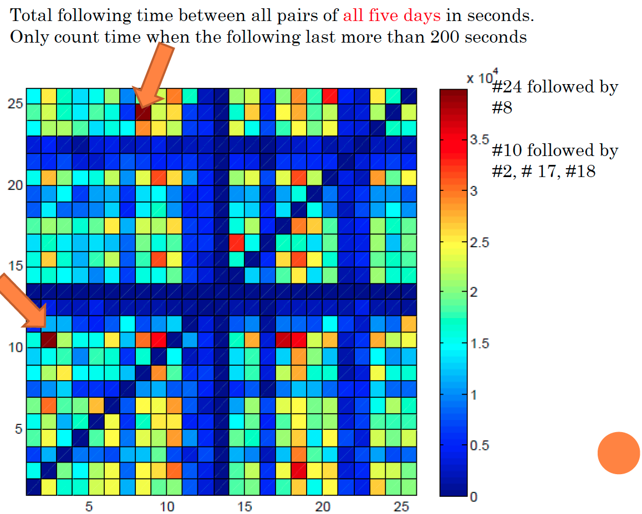
Future Work: From Pairs to Social Network
Thanks! Questions?

Slide 23
Supplementary slides

Slide 24
Significant Following Time Interval
if s_{j} is the local minimizer for r_{i}
j < i, f(i) = 1(r_{i} follows s_{j})
j ≥ i, f(i) = 0 (r_{i} not follow s_{j})
if r_{i} has no local minimizer, f(i)=x
Significant following time interval I should have higher following frequency than expected
Expected following frequency:
If R and S are moving together, we expect half following (1s) and half non-following (0s)
Following score (difference between actual and expected frequency):

Slide 25
Maximal Segment = the Following Time Intervals
Maximal segment: [3,11]
R follows S from r₃ to r₁₁ and
then moves together with S from r₁₂ to r₁₄

Slide 26
Reverse Test
Relationship symmetry: if r_{i} follows s_{j}, s_{j} should lead r_{i}
s₇ is local minimizer for r₇ → r₇ follows s₇
r₇ is the local minimizer for s₇ → s₇ leads r₇
Satisfy symmetry
s₇ is local minimizer for r₈ → r₈ follows s₇
r₈ is not the local minimizer for s₇ → s₇ does not lead r₈
Not satisfy symmetry

Slide 27
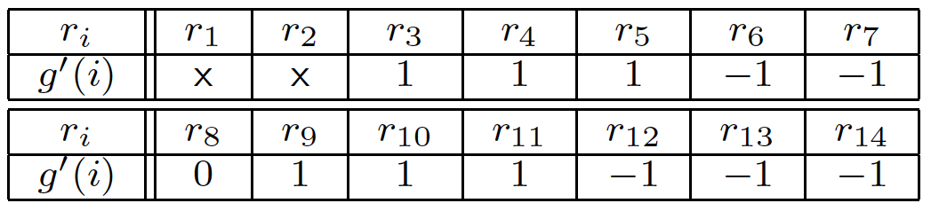
Reverse Test Modifies Following Score
Value 1 remains if pass reverse test
Value 1 becomes 0 if fail reverse test
Value 0 becomes -1
Not satisfy symmetry, value 1 becomes 0
Then, same Maximal Segment method can be applied

Slide 28
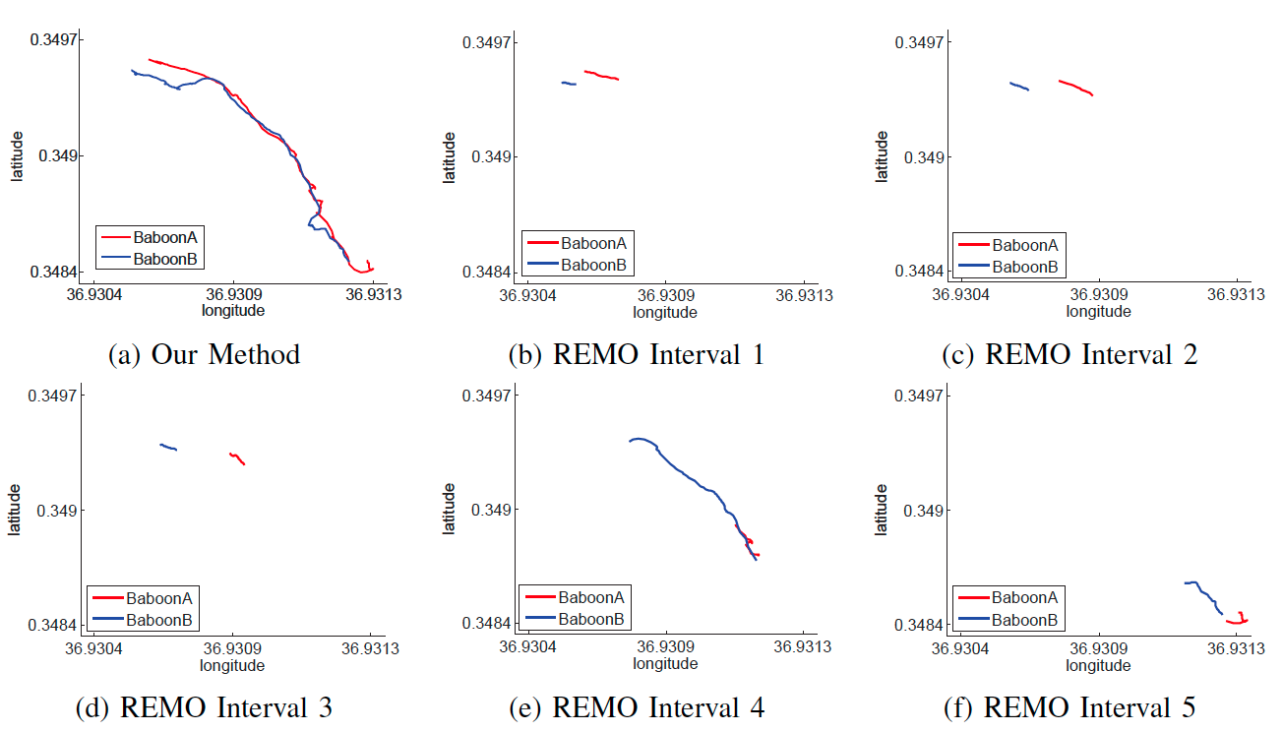
Case Study for Method Comparison

